Slide 1
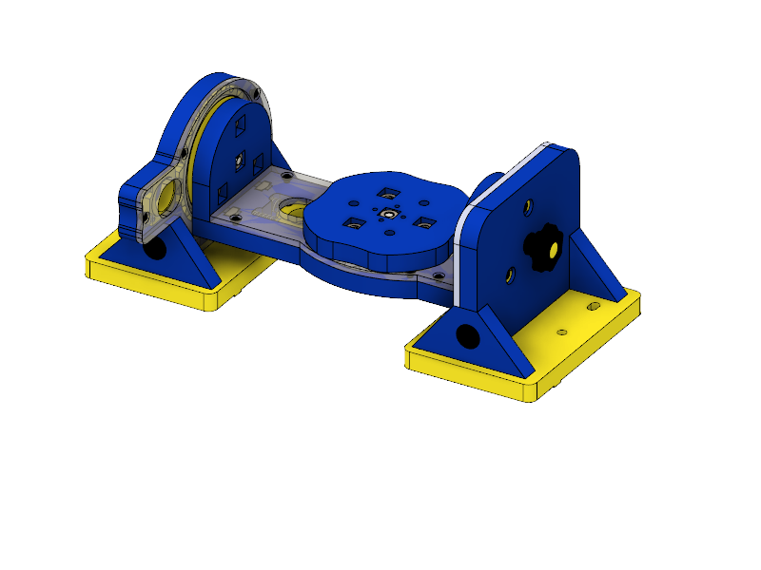
Manual +2 Axis Accessory (004588) SBX 332 - Assembly
Driving Side
Driven Side
Trunnion

Slide 2
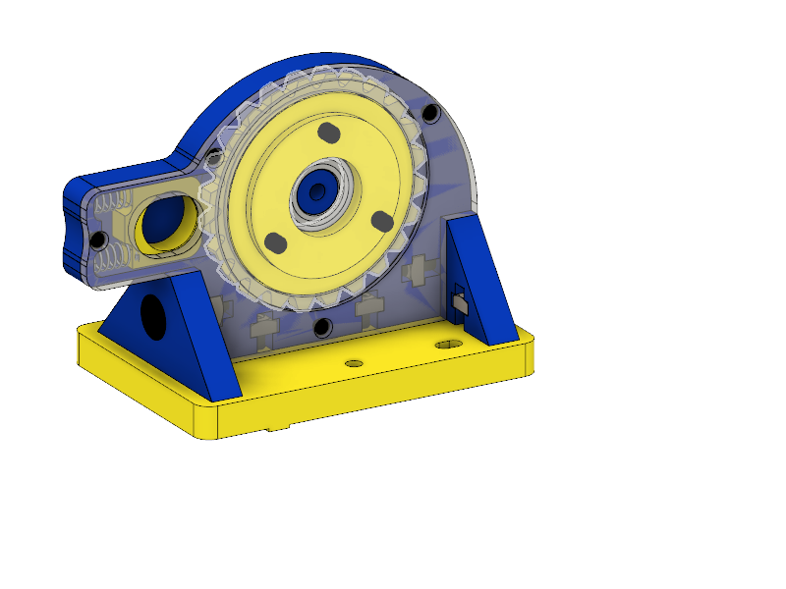
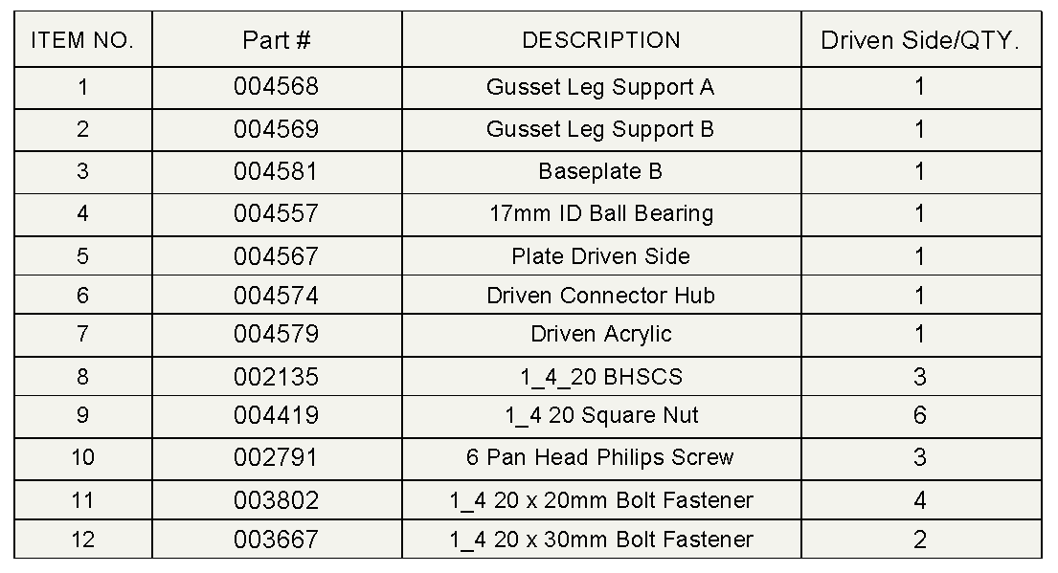
Driving Side Subassembly
Bill of Materials

Slide 3
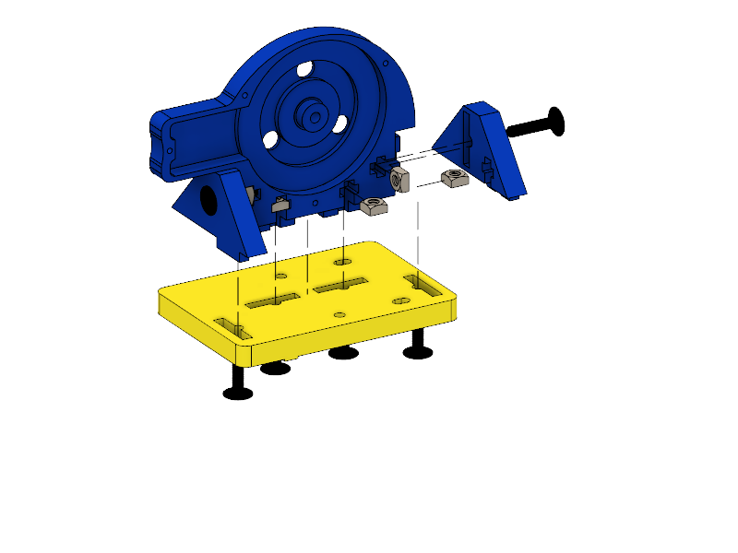
(004566)
(004568)
2x (003667)
(004569)
6x (004419)
4x (003802)
(004576)

Slide 4
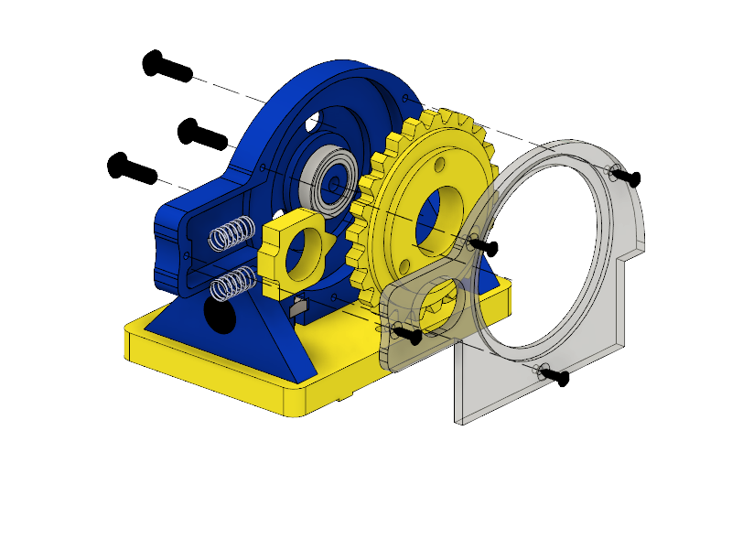
3x (002135)
(004557)
(004573)
(004577)
2x (004562)
(004575)
4x (002791)

Slide 5
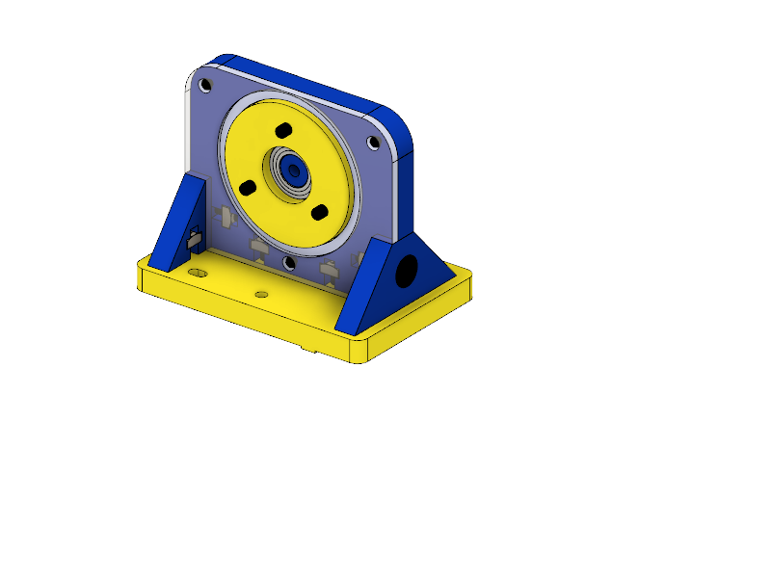
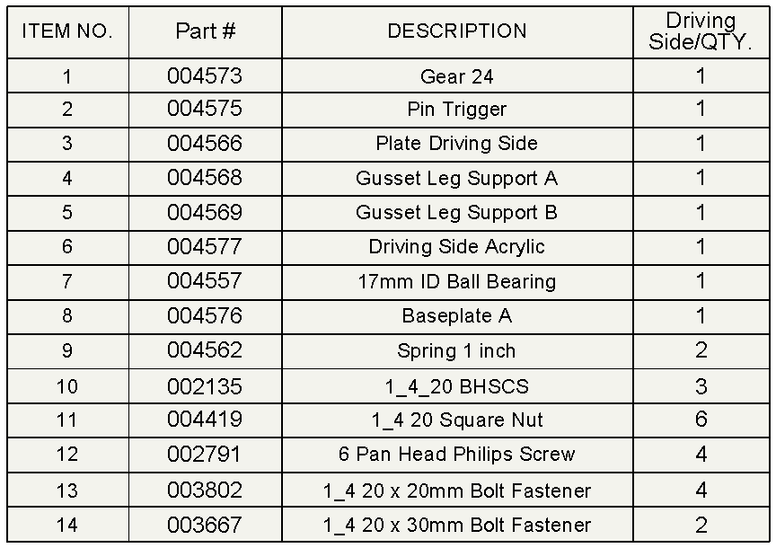
Driven Side Subassembly
Bill of Materials

Slide 6
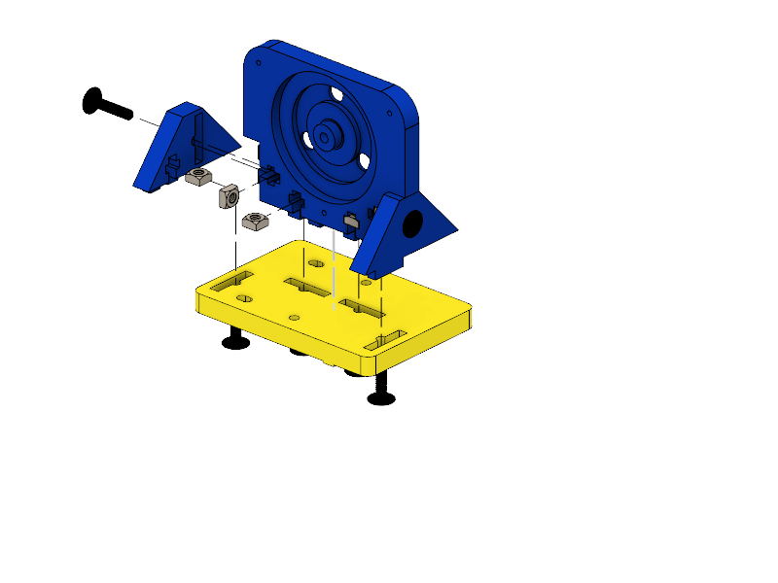
2x (003667)
(004567)
(004569)
(004568)
6x (004419)
4x (003802)

Slide 7
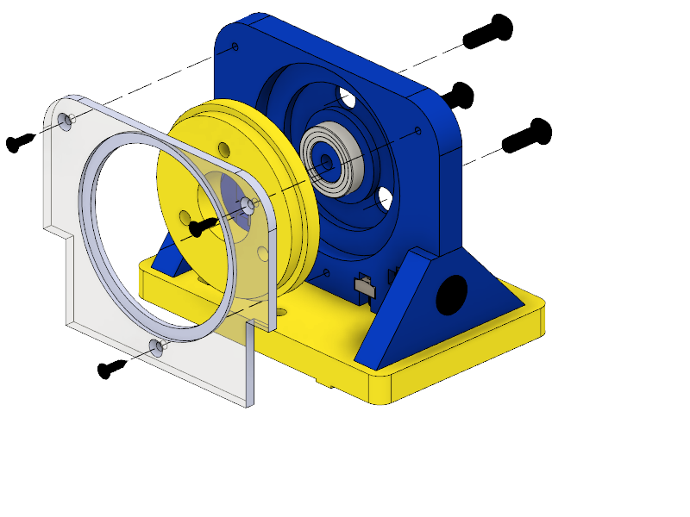
(004557)
3x (002135)
3x (002791)
(004579)
(004574)

Slide 8
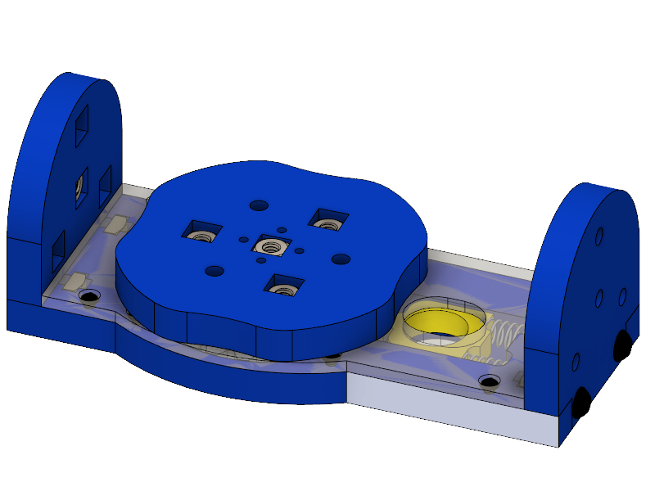
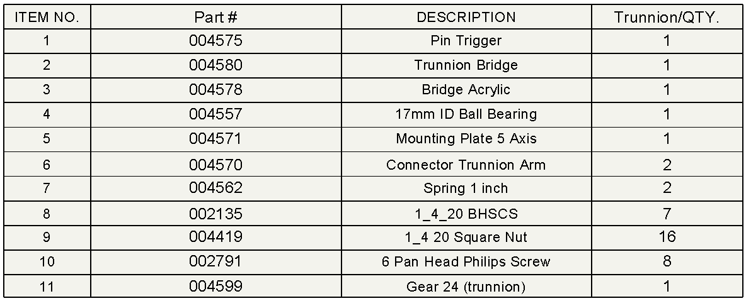
Trunnion Subassembly
Bill of Materials

Slide 9
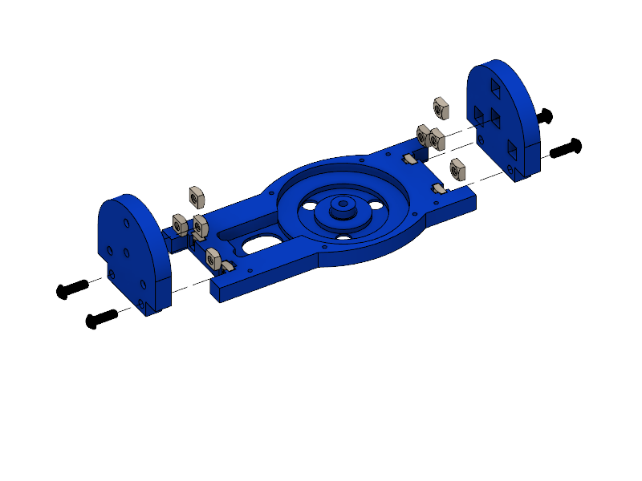
2x (004570)
12x (004419)
(004580)
4x (002135)

Slide 10
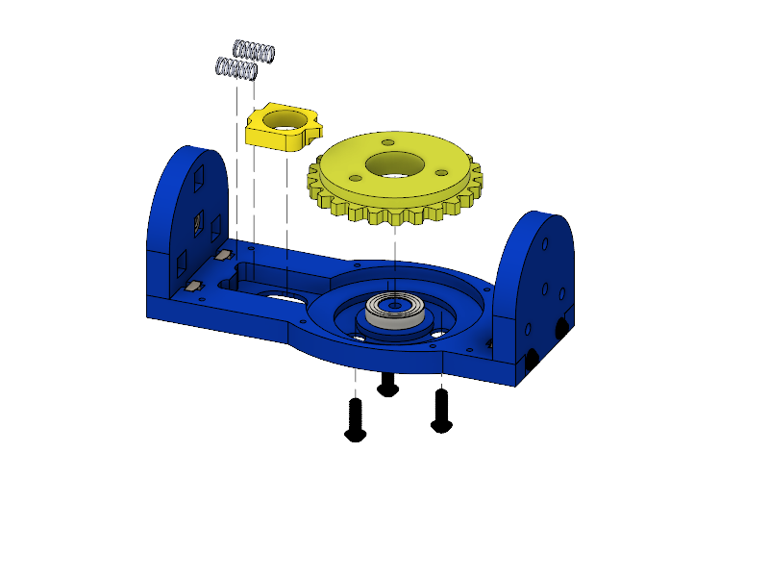
2x (004562)
(004575)
(004599)
(004557)
3x (002135)

Slide 11
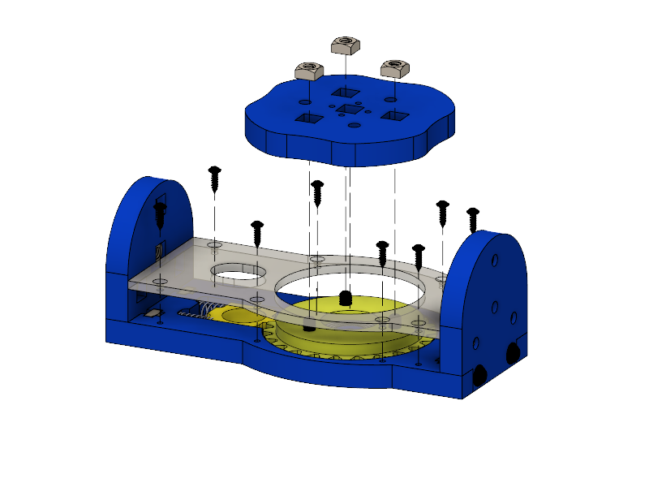
4x (004419)
8x (002791)
(004571)
(004578)

Slide 12
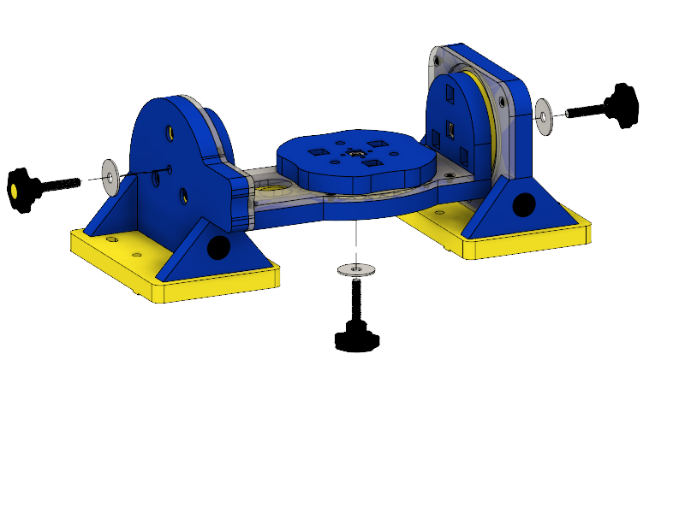

Final Assembly
3x (004564)
3x (004563)
Bill of Materials

Slide 13
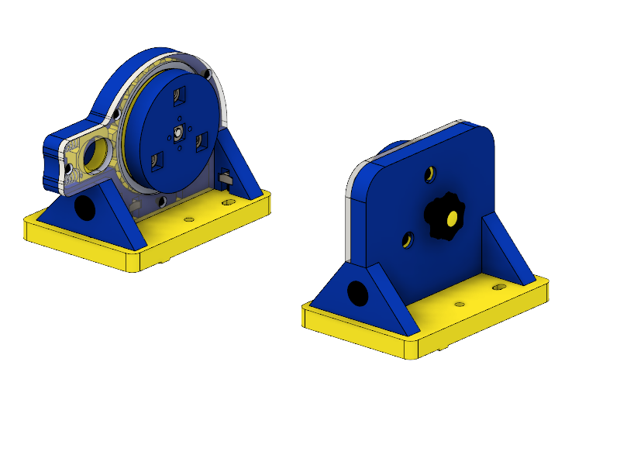
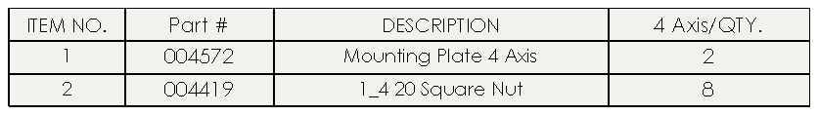
4 Axis Configuration
2x (004572)
8x (004419)
Bill of Materials

